Slide 1
Swiss Re overview

Slide 2
Founded in 1863
Acquired GE Insurance 2006

Slide 3
Incident Management Problem Management IMPM

Slide 4
incident
Unplanned interruption
Service Quality
Customer Product

Slide 5
Incident Management Process
Triage
Goal of IM
The triage team then validates the ticket on priority, Configuration Item, incident type and assigns to right application or person for further analysis of ticket.(reportedstage to closedstage)

Slide 6
Response time
Dear User, We have acknowledged your request. We will analyze & get back to you with an update
3 types of application
Platinum-MyHR
Gold-CONCOR
Silver-payrolls

Slide 7
Priority
Priority
Impact and urgency
Critical
High
Medium
Standard

Slide 8
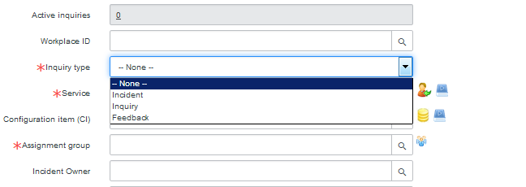
IMP – in progress
As soon as incident owner sees a ticket, a quick check on Inquiry type (Inquiry, Incident,Feedback) priority is made.
Ticket update should happen atleast with a minimum frequency of 4 days either in customer communication field or in work notes of SNOW

Slide 9
Customer needs to be kept informed on the progress at regular intervals through customer communication field in SNOW

Slide 10
If the issue raised is caused due to a recent change/deployment, ensure to follow the below mentioned steps
CR number/case number to be in added into the "External Id field
High level description of the change to be commented in work notes

Slide 11
ICM – Waiting for Customer
There are two reasons of waiting for statuses and the applicability of each status is detailed below.
This waiting reason is used in case further information from customer is needed to further investigate the issue, or if the confirmation that the reported issue is resolved is needed.

Slide 12
Comments must be updated in the 'Customer Communication' field of incident
All the communication made to customer needs to be in simple business language, avoiding technical jargon as much as possible and in a way that’s easy for customer to understand

Slide 13
A status change to Customer will also trigger a notification to user
3 strike below
Time for Appointment/meeting with customer is arranged to discuss the issue for further analysis or confirmation of issue resolution is seeked. The agreed time must be documented in the customer communication field before the status gets changed

Slide 14
ICM – Waiting For Dependency
This waiting reason is used when
Problem resolution or change initiated for an incident
Agreed event in the future (i.e. salary raise) initiated for an incident
Comments need to be updated in the either 'Customer Communication' /Work note field of incident

Slide 15
Problem resolution
If there is any issue with the product (Example: SF/Coupa etc), an case is raised to contact (Example: SF/Coupa etc), for the same. The same will be notified to the Application Manager. A problem ticket will be created for the same and the issue is tracked though the problem ticket. The problem ticket is linked to the problem ticket and further analysis is done.
When the action either resolution or clarification is needed by a third party vendor and/or any other stakeholder not available in SNOW
When multiple tickets are raised for the same issue, a problem ticket is created
When there is no workaround or timely resolution available for an incident that’s being worked upon
Any known potential issue (pro-active problem management).

Slide 16
Resolved
The status of ticket is changed to resolved only when
The root cause is identified and a permanent resolution is in place
Do a quick check in the database to see if this is a known error; If so, apply the solution

Slide 17
Problem Management Process
A problem ticket can be created for various multiple reasons as detailed below including both pro-active problem management and/or re-active problem management.
Proactive
Reactive

Slide 18
If there is any issue with the product (Example: SF/Coupa etc), an case is raised to contact (Example: SF/Coupa etc), for the same. The same will be notified to the Application Manager. A problem ticket will be created for the same and the issue is tracked though the problem ticket. The problem ticket is linked to the problem ticket and further analysis is done.
When multiple tickets are raised for the same issue, a problem ticket is created
When there is no workaround or timely resolution available for an incident that’s being worked upon
Any known potential issue (pro-active problem management)

Slide 19
open
The initiate state of a problem ticket is open when its created. Either the problem owner or triage team validates the ticket on priority, CI, Prefix code and assigns to right group/person for further analysis of ticket.
In Analysis
Update min frequency 4 days

Slide 20
----In Analysis – 3rd party relevant
flag checked
CN in External ID
Update once in a week

Slide 21
3rd party relevant status
Pending feedback system provider
Fixed – ready for testing
Tested successfully
Retest failed
Fixed for future release

Slide 22
Waiting for change

